Slide 1
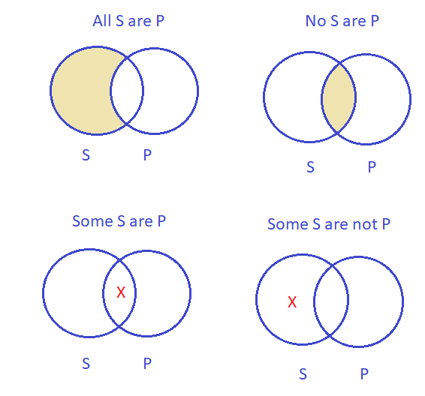
Chapter 9 Categorical Logic
Notes:
In this Chapter, we’ll learn about a tool to test validity of our arguments, more specifically, our categorical arguments.
This is a useful tool for us to make quality deductive arguments, not saying something silly that other people may laugh at. ☺
A category is a class/group of entities/items. In categorical logic, we have three standard categories: All (items), No (items), and Some (items).
Remember that ‘Some’ is a wide range, from more than one to almost all. In other words, ‘Some’ is between ‘No’ and ‘All’.

Slide 2
CONTENTS
Part 1: Categorical propositions/claims
Part 2: Translating into standard propositions/claims
Part 3: Testing validity with Venn diagram

Slide 3
Part 1: Categorical propositions/claims
Categorical propositions/claims make declarations about entities belonging to, or not belonging to, categories or classes. Each standard categorical proposition has 4 basic parts:
1. Quantifier: All, No, or Some
2. Subject: (S) (plural noun)
3. Predicate: (P) (plural noun)
4. Copula: linking verb (always ‘are’)
Ex: All IU students are Critical Thinking learners.
1 2 4 3
Notes:
Regarding meaning, a proposition is a sentence which expresses a complete idea.
Regarding structure, a standard categorical proposition consists of four parts as in the above example:
1. Quantifier: shows the number of items (All, No, Some)
Subject: the agent of the verb (the standard subject is always a plural noun)
Predicate: the object of the verb (the standard predicate is always a plural noun)
Copula: the main verb (the standard verb is always ‘are’)

Slide 4
Part 1: Categorical propositions/claims
All S are P
No S are P
Some S are P
Some S are not P
S
P
Notes:
In logic, there are four basic propositions. In these propositions, the two categories are symbolized as S (Subject) and P (Predicate). You need to remember these four propositions, and there is not a standard proposition ‘All S are not P’ or ‘No S are not P’.

Slide 5
Venn diagram for a categorial proposition
S: IU students
S
P
P: CT learners
All S are P
No S are P
No P are S
All IU students (S) are Critical Thinking learners (P).
No IU students (S) are Critical Thinking learners (P).
No Critical Thinking learners (P) are IU students (S).
Notes:
This simple diagram of two overlapping circles shows the relation between two categories.
Example: S: IU students and P: Critical Thinking learners (S and P: plural categories)

Slide 6
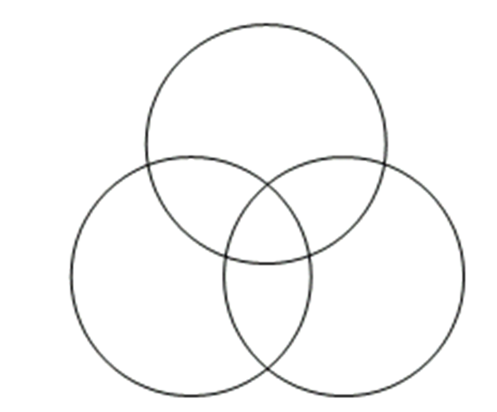
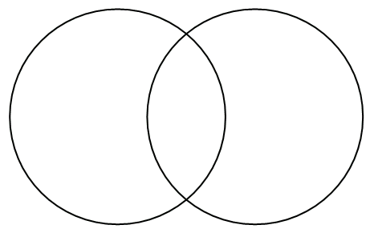
Venn Diagram for categorical propositions and arguments
Venn diagram, invented by John Venn, is a very useful method of diagramming the informational content of categorical logic.
A Venn diagram for a categorical proposition consists of 2 overlapping circles. (Figure A)
A Venn diagram for a categorical argument consists of 3 interlocking circles. (Figure B)
Figure A
Figure B
Notes:
Venn is the name of British mathematician John Venn who invented this method.
A Venn diagram shows all possible logical relations between categories. In this Chapter, we’ll use a Venn diagram of three interlocking circles to test validity of categorical arguments.

Slide 7
Two simple rules governing Venn diagram
1. Shade an area to show that it is empty.
2. Place an X in an area to show that it is occupied by some item (at least one item).
X
X
Delete it
One item at least
X can be in
two categories
Notes:
You need to master the rules to do your evaluation later:
When you shade an area (symbolizing a class of items), as in 1, this means you DELETE that area and it disappears.
When you put an X in an area, it means there is at least ONE item in that area, or X means “some”.

Slide 8
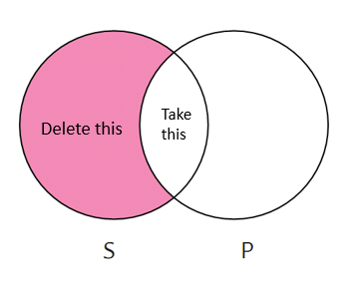
All S are P
Two simple rules governing Venn Diagram
Notes:
In this case, when you have the proposition ‘All S are P’, you shade the S area outside P in pink, which means any items in the pink area disappear because they are only S and they are not P.
So, ‘All S are P’ is the oval area between the two circles, because all items in this area are both S and P.

Slide 9
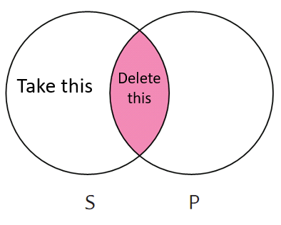
No S are P
Two simple rules governing Venn Diagram
Notes:
Similarly, you delete the common area in the center for ‘No S are P’, and take all items in S outside the common area.
Likewise, for ‘No P are S’, you delete the same common area inside, but you take all the items in P outside the common area.

Slide 10
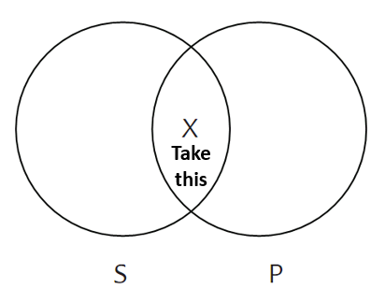
Some S are P
Two simple rules governing Venn Diagram
Notes:
You put an X in the common area of S and P, for both ‘Some S are P’ or ‘Some P are S’
Remember: when you put an X in an area, that means to take that area.

Slide 11
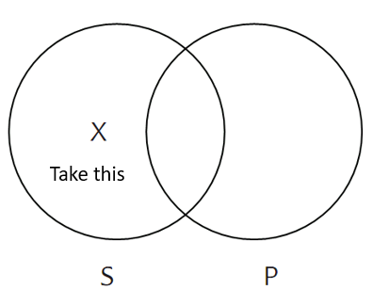
Some S are not P
Two simple rules governing Venn Diagram
Notes:
When X is in the outside area of S, you take ‘Some S are not P’.

Slide 12

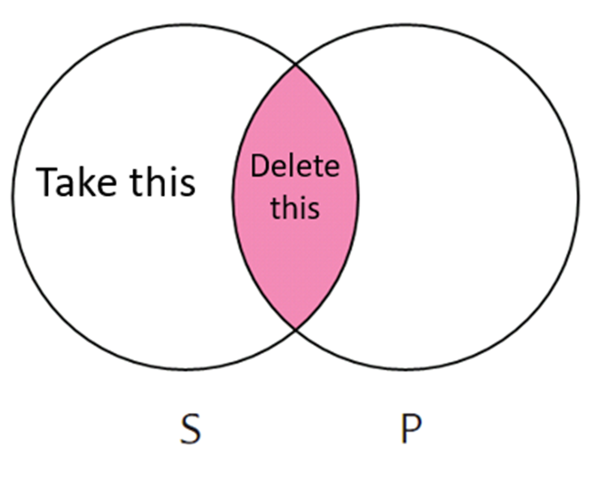
Review: Venn diagram for 4 categorical claims
All S are P: The class of S outside of P is empty.
No S are P: The class of S inside P is empty.
Some S are P: The class of S inside P has at least one member.
Some S are not P: The class of S outside of P has at least one member.
All S are P
No S are P
Some S are P
Some S are not P
Some
No
All

Slide 13
Common stylistic variants of categorical claims
All S are P
Every S is a P. Whoever is an S is a P.
Whatever is an S is a P. If anything is an S, then it is a P.
Any S is a P. If something is not a P, then it is not an S.
Each S is a P. S are all P.
S are always P. Only P are S.
The only S are P. Only if something is a P is it an S.
Something is an S only if it is a P.
Notes:
In life, we do not always speak in 4 standard propositions. Therefore, we have to convert all stylistic variants (paraphrased propositions) into the standard forms.
Tip to remember: All the propositions with words of extremes (any, always, only, whatever, whoever…) in the positive forms are converted into ‘All S are P’.
Attention: ‘If something is not a P, then it is not an S.’: double negative also means positive.

Slide 14
Common stylistic variants of categorical claims
No S are P
No P are S.
S are not P.
Nothing that is an S is a P.
No one who is an S is a P.
None of the S is a P.
Not a single S is P.
If anything is an S then it is not a P.
All S are non-P.
Notes:
Tip to remember: These variants contain words of extremes in negative forms.

Slide 15
Common stylistic variants of categorical claims
Some S are P
Some P are S.
A few S are P.
There are S that are P.
Several S are P.
Many S are P.
Most S are P.
Nearly all S are P.
Notes:
Tip to remember: These variants contain quantifiers ranging from ‘’more than one’ to ‘nearly all’, and they are in the positive forms.

Slide 16
Common stylistic variants of categorical claims
Some S are not P
Not all S are P.
Not everyone who is an S is a P.
S are not always P.
Some S are non-P.
There are S that are not P.
A few S are not P.
Several S are not P.
Most S are not P.
Nearly all S are not P.
Notes:
Tip to remember: These variants contain quantifiers ranging from ‘more than one’ to ‘nearly all’, and they are in the negative forms.

Slide 17
Practice: Translate the following “only sentences” into standard categorical form.
1. Only IU students learn Critical Thinking in English.
All learners of Critical Thinking in English are IU students.
2. Only fools follow the crowd.
All crowd followers are fools.
3. Employees’ restroom only.
All restroom users are employees.
4. None except senior citizens are eligible for the vaccination.
All people who are eligible for the vaccination are senior citizens.
5. Building residents alone may use the elevator.
All users of the elevator are building residents.
Notes:
Attention:
1. ‘All learners of Critical Thinking in English are IU students.’ is different from ‘All IU students are learners of Critical Thinking in English.’ because the area that you shade (delete) is different.
After you translate a stylistic variant, you will have a standard categorical proposition with four elements: quantifier, subject, copula, predicate.
Example: All people who use the restroom are employees.
Quantifier: all
Subject: learners, crowd followers, people, users (plural)
Copula: are
Predicate: students, fools, employees, citizens, residents (plural)

Slide 18
Practice: Translate the following sentences into standard categorical form.
1. There are birds that cannot sing.
2. Deductive arguments are not inductive arguments.
3. Polar bears live in Canada.
4. If you learn online, you use at least one online meeting platform.
5. Not all online meeting platforms are user-friendly.
Some birds are animals that cannot sing.
No deductive arguments are inductive arguments.
Some polar bears are animals which live in Canada.
All online learners are users of at least one online meeting platform.
Some online meeting platforms are not user-friendly devices.
Notes:
Attention:
2. When there are no quantifiers, we need to check the meaning of the subject and object to decide on the standard quantifier, as in example 2.
3. When we say ‘Polar bears in Canada’, we don’t generalize all of polar bears. Likewise, if we say ‘Vietnamese people are friendly’, it means ‘some Vietnamese’ (from more than one to nearly all), but we don’t generalize ‘all’.

Slide 19

Task: Translate the T-shirt statement into the standard categorical form

Slide 20
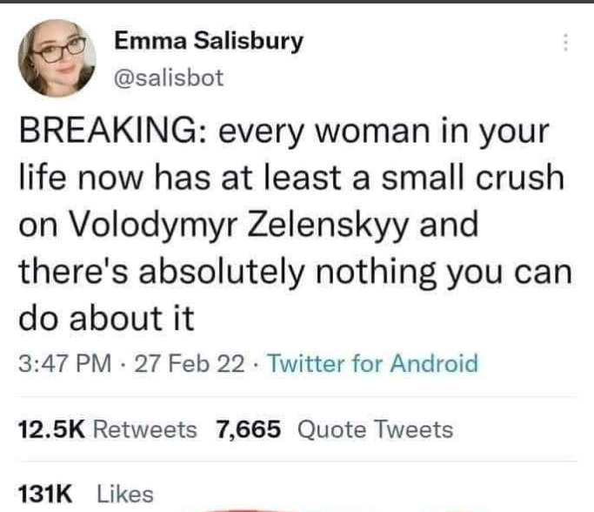

Task: Translate the Emma’s statement into the standard categorical form
Ukraine President
Notes:
All women are people who have a crush on Volodymyr Zelenskyy.
No men are people who can stop women’s crush on VZ.

Slide 21

Task: Translate Judge Jeanine’s statement into the standard categorical form
Background: The U.S. is divided on the policy of teaching sexuality to third graders.
(Fox News - April 1, 2022)

Slide 22
Part 2: Translating into standard categorical propositions
A standard categorical proposition has:
Quantifier: All, No, Some
S and P: plural nouns
Copula: are, are not
Notes:
All S and P are turned into plural categories.
All verbs are turned into ‘are’.
Add suitable quantifiers depending on the context.
4 + 5: If there is a stylistic variant, you must turn it into one of the four standard forms.

Slide 23
Part 2: Translating into standard categorical propositions
Tip 1: Rephrase all nonstandard subject and predicate terms so that they refer to plural categories/classes.
Ex: Some roses are white.
Some roses are white flowers.
Q S C P
Notes:
In this proposition, we have standard elements:
quantifier ‘some’
plural subject ‘roses’
copula ‘are’
There is no predicate, so we have to add ‘flowers’ to have a plural predicate ‘white flowers’.

Slide 24
Part 2: Translating into standard categorical propositions
Tip 2: Rephrase all nonstandard verbs.
Ex: Some students walk to school.
Some students are people who walk to school.
Q S C P
Notes:
The verb ‘walk’ is not a standard copula, so we rephrase it into ‘are’, and we also rephrase ‘people’ accordingly.

Slide 25
Part 2: Translating into standard categorical propositions
Tip 3: Fill in any unexpressed quantifiers.
Ex: Vietnamese people are friendly.
Some Vietnamese people are friendly citizens.
Q S C P

Slide 26
Part 2: Translating into standard categorical propositions
Tip 4: Translate singular statements as all or no statements.
Ex: Paris is the capital of France.
All places identical with Paris are places that are the capital of France.
Q S C P
Notes:
It sounds silly in this case, but we need to turn a singular subject or predicate into a plural one. ☺

Slide 27
Part 2: Translating into standard categorical propositions
Tip 5: Translate stylistic variants into the appropriate categorical form.
Every S is a P.
Any S is a P.
S are always P.
All S are P

Slide 28
Review: Translating into standard categorical form
Follow five tips:
Tip 1: Rephrase all nonstandard subject and predicate terms so that they refer to plural categories.
Tip 2: Rephrase all nonstandard verbs.
Tip 3: Fill in any unexpressed quantifiers.
Tip 4: Translate singular statements into all, no or some statements.
Tip 5: Translate stylistic variants into the appropriate categorical form.
Notes:
All S and P are turned into plural categories.
All verbs are turned into ‘are’.
Add suitable quantifiers depending on the context.
4 + 5: If there is a stylistic variant, you must turn it into one of the four standard forms.

Slide 29
Part 3: Testing validity of a categorical syllogism
A categorical syllogism is deductive argument with two premises and a conclusion.
Example: All Venn drawers (D) are logic learners (L).
All logic learners are critical thinkers (T).
So, all Venn drawers are critical thinkers.
Notes:
Review:
Remember: when we talk about validity, it is all about deductive arguments. (For inductive arguments, it’s not validity but strength)
The example above is a syllogism (a three-line argument: a major premise, a minor premise, and a conclusion)
In this example, all three propositions are already in their standard forms with Q + S + C + P.

Slide 30

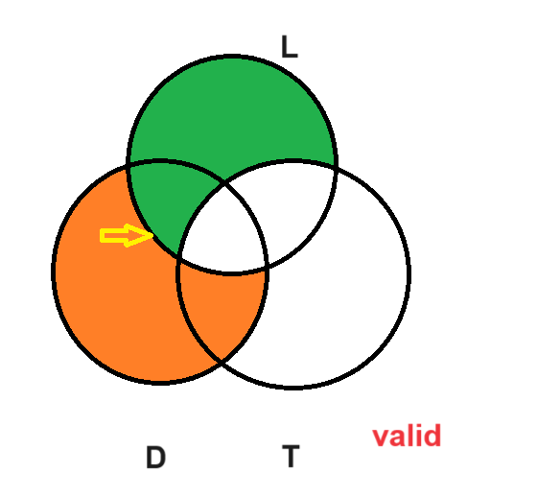
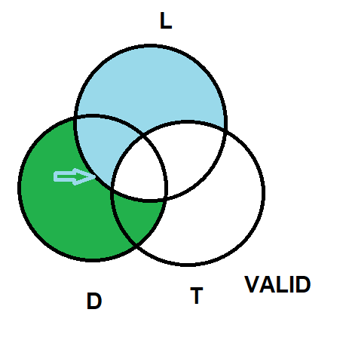
Part 3: Testing validity of a categorical syllogism
Sample 1
Yes
No
All Venn drawers (D) are logic learners (L).
All logic learners (L) are critical thinkers (T).
So, all Venn drawers (D) are critical thinkers (T).
The two lower circles represent the two categories in the conclusion.
All D are L.
All L are T.
So, all D are T.
D
T
Notes:
The Venn diagram for testing validity has three interlocking circles, representing three categories. TO BE CONSISTENT, ALWAYS DRAW TWO CIRCLES AT THE BASE AND ONE CIRCLE ON TOP.
Important: Always put the two categories in the conclusion at the base.
Draw Venn diagram on PPTX:
Step 1: Draw and select three interlocking circles
Step 2: Shape format -> merge shapes -> fragment
Step 3: Format shape -> pattern fill

Slide 31
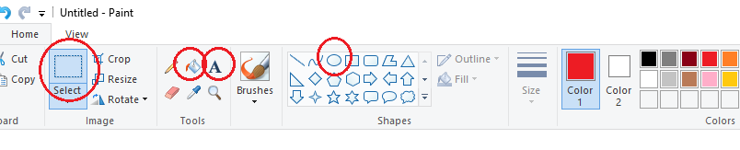
HOW TO DRAW VENN DIAGRAM
Instructions:
Go to Paint to draw the Venn diagram:
Click the oval shape to draw the 3 circles
Click the bucket to shade the areas
Click A to add and format text
Click Select, then Ctrl + C to copy the image and paste on slides

Slide 32
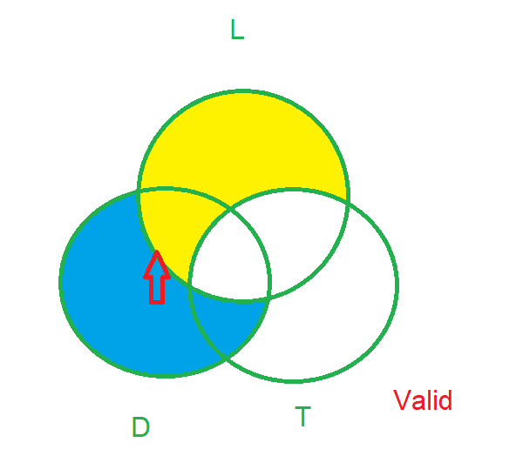
Part 3: Testing validity of a categorical syllogism
Sample 1
Yes
No
All Venn drawers (D) are logic learners (L).
All logic learners (L) are critical thinkers (T).
So, all Venn drawers (D) are critical thinkers (T).
The two lower circles represent the two categories in the conclusion.
All D are L.
All L are T.
So, all D are T.
Notes:
The Venn diagram for testing validity has three interlocking circles, representing three categories. TO BE CONSISTENT, ALWAYS DRAW TWO CIRCLES AT THE BASE AND ONE CIRCLE ON TOP.
Important: Always put the two categories in the conclusion at the base.
Draw Venn diagram on PPTX:
Step 1: Draw and select three interlocking circles
Step 2: Shape format -> merge shapes -> fragment
Step 3: Format shape -> pattern fill

Slide 33
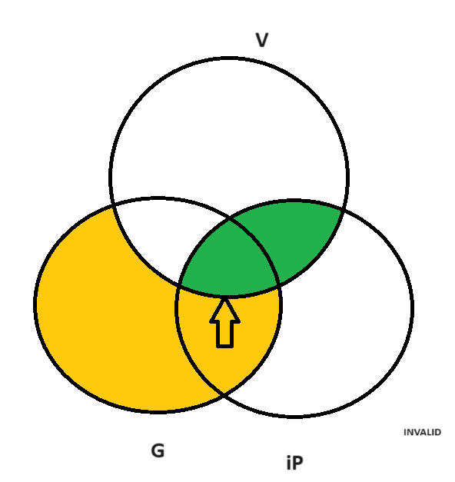
Part 3: Testing validity of a categorical syllogism
Sample 2
No iPhones are Vsmarts. All Samsung Galaxies are Vsmarts. So, some Samsung Galaxies are iPhones.
A
Symbolic argument:
No iP are V
All G are V
So, some G are iP
A
A
Notes:
From this slide onwards, you need one more step: label the three categories and have a simple formula before you perform the three steps. These labels should have the letters from the words (i.e. iP for iPhone, or V for Vsmart) so that you can recognize them easily. If you label A, B, C, it takes more time to work out what they mean.
Now follow three steps:
Shade/delete the common area of iP and V.
Shade/delete the outside area of G (which are not V). This action means we take the inside, not the outside.
Look: Some G are iP: if we do this action, we’ll put an X in the common area of G + iP. But now we don’t see any X in this area. This means the action is not yet done by the two actions before, or the conclusion does not follow from the two premises. Therefore, this conclusion is INVALID.
Draw Venn diagram on PPTX:
Step 1: Draw and select three interlocking circles
Step 2: Shape format -> merge shapes -> fragment
Step 3: Format shape -> pattern fill

Slide 34
Part 3: Testing validity of a categorical syllogism
Sample 2: Answer
No iPhones are Vsmarts. All Samsung Galaxies are Vsmarts. So, some Samsung Galaxies are iPhones.
V
Symbolic argument:
No iP are V
All G are V
So, some G are iP
Invalid
G
iP
Notes:
Draw Venn diagram on PPTX:
Step 1: Draw three interlocking circles
Step 2: Shape format -> merge shapes -> fragment
Step 3: Format shape -> pattern fill

Slide 35
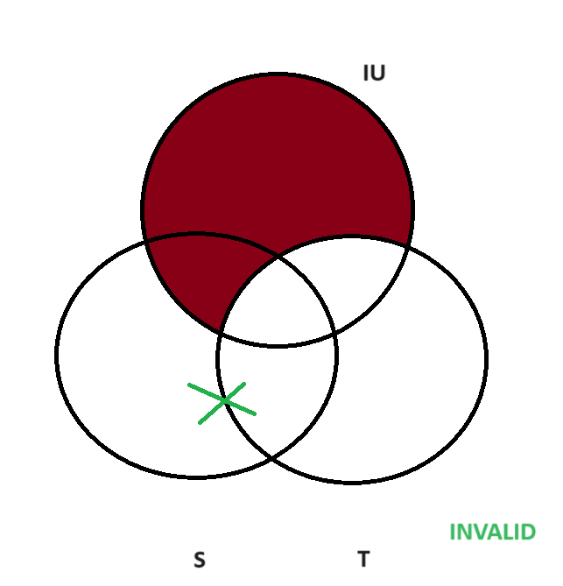
Part 3: Testing validity of a categorical syllogism
Sample 3
If you are an IUer, you tease the Koi fish.
Some students don’t attend IU programs.
So, some students don’t tease the Koi fish.
A
Standardized argument:
All IUers (IU) are Koi teasers (T).
Some students (S) are not IUers.
So, some students are not Koi teasers.
Symbolic argument:
All IU are T
Some S are not IU
So, some S are not T
A
A
Notes:
Draw Venn diagram on PPTX:
Step 1: Draw and select three interlocking circles
Step 2: Shape format -> merge shapes -> fragment
Step 3: Format shape -> pattern fill

Slide 36
Part 3: Testing validity of a categorical syllogism
Sample 3 - Answer
If you are an IUer, you tease the Koi fish.
Some students don’t attend IU programs.
So, some students don’t tease the Koi fish.
IU
Standardized argument:
All IUers (IU) are Koi teasers (T).
Some students (S) are not IUers.
So, some students are not Koi teasers.
Symbolic argument:
All IU are T
Some S are not IU
So, some S are not T
S
T
This is an invalid argument. The “X” shows that there may be some S that are not L, but not necessarily.
Notes:
Draw Venn diagram on PPTX:
Step 1: Draw and select three interlocking circles
Step 2: Shape format -> merge shapes -> fragment
Step 3: Format shape -> pattern fill

Slide 37
Part 3: Testing validity of a categorical syllogism
Sample 4
No islands are part of the mainland. Hawaii is an island. Therefore, Hawaii is not on the mainland.
A
Standardized argument:
No islands (I) are mainland areas (M).
All places identical with Hawaii (H) are islands.
So, no places identical with Hawaii are mainland areas.
Symbolic argument:
No I are M
All H are I
So, no H are M
A
A
Notes:
In this example, you must follow the steps:
1. Standardize all the premises and the conclusion: Hawaii is the singular proper noun and the verb “is” are not standard.
2. Label the categories and have a formula.
3. Do the two actions (Steps 1 + 2) and remember ALWAYS to do the All or No premises before the Some premise. In this example, there is no Some premise, so you just follow the order.
Draw Venn diagram on PPTX:
Step 1: Draw and select three interlocking circles
Step 2: Shape format -> merge shapes -> fragment
Step 3: Format shape -> pattern fill

Slide 38
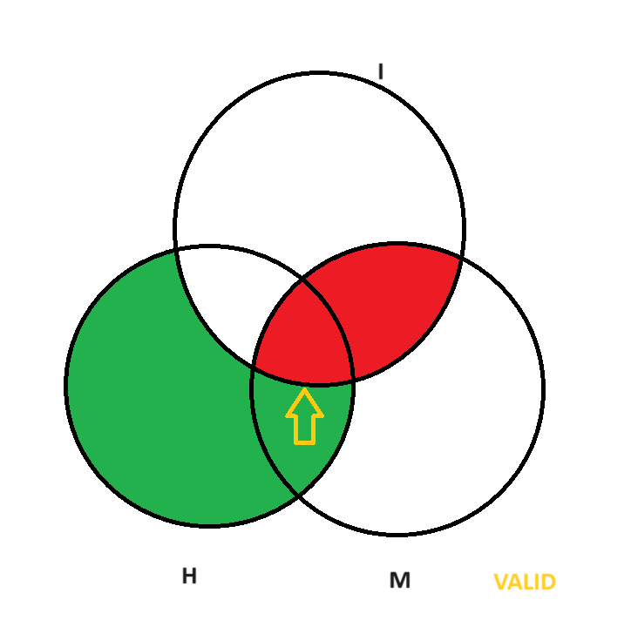
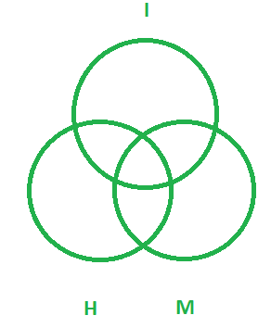
Part 3: Testing validity of a categorical syllogism
Sample 4 - Answer
No islands are part of the mainland. Hawaii is an island. Therefore, Hawaii is not on the mainland.
Standardized argument:
No islands (I) are mainland areas (M).
All places identical with Hawaii (H) are islands.
So, no places identical with Hawaii are mainland areas.
Symbolic argument:
No I are M
All H are I
So, no H are M
This is a valid argument. The whole area where all H are M is already shaded by the two previous actions. This means the conclusion follows from the two premises.
Notes:
In this example, you must follow the steps:
1. Standardize all the premises and the conclusion: Hawaii is the singular proper noun and the verb “is” are not standard.
2. Label the categories and have a formula.
3. Do the two actions (Steps 1 + 2) and remember ALWAYS to do the All or No premises before the Some premise. In this example, there is no Some premise, so you just follow the order.

Slide 39
Part 3: Testing validity of a categorical syllogism
Sample 5
Some students don’t love logic.
Most people who love logic make sound arguments.
So, there are students who don’t make sound arguments.
Standardized argument:
L
Some students (S) are not logic lovers (L).
Some logic lovers are sound argument makers (M).
So, some students are not sound arguments makers.
Symbolic argument:
Some S are not L
Some L are M
So, some S are not M
S
M
Notes:
In this example, you must follow the steps:
1. Standardize all the premises and the conclusion, which are the stylistic variants of the Some proposition.
2. Label the categories and have a formula.
3. Do the two actions (Steps 1 + 2) and remember ALWAYS to do the All or No premise before the Some premise. In this example, there are only Some premises, so you just follow the order.
Draw Venn diagram on PPTX:
Step 1: Draw and select three interlocking circles
Step 2: Shape format -> merge shapes -> fragment
Step 3: Format shape -> pattern fill

Slide 40
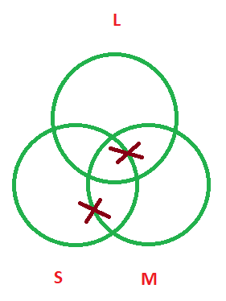
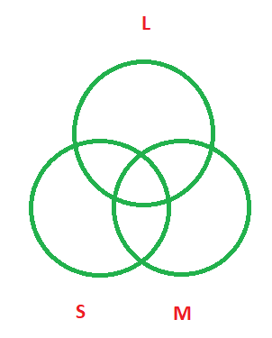
Part 3: Testing validity of a categorical syllogism
Sample 5 - Answer
Some students don’t love logic.
Most people who love logic make sound arguments.
So, there are students who don’t make sound arguments.
Standardized argument:
Some students (S) are not logic lovers (L).
Some logic lovers are sound argument makers (M).
So, some students are not sound arguments makers.
Symbolic argument:
This is an invalid argument. For the conclusion, we expect an X on the line in the area of S outside M. However, X is not in the expected place.
Some S are not L
Some L are M
So, some S are not M
Notes:
In this example, you must follow the steps:
1. Standardize all the premises and the conclusion, which are the stylistic variants of the Some proposition.
2. Label the categories and have a formula.
3. Do the two actions (Steps 1 + 2) and remember ALWAYS to do the All or No premise before the Some premise. In this example, there are only Some premises, so you just follow the order.

Slide 41
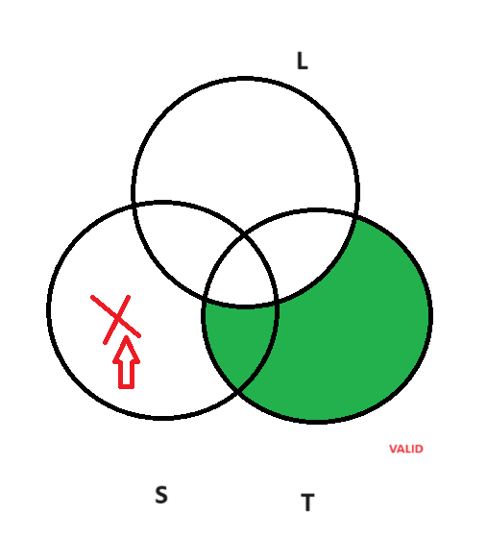
Part 3: Testing validity of a categorical syllogism
Sample 6
Some students are not learning Categorical Logic.
Only if they learn Categorical Logic can they do the test well.
So, at least one student cannot do the test well.
Standardized argument:
A
Some students (S) are not CL learners (L).
All good test takers (T) are CL learners.
So, some students are not good test takers.
Symbolic argument:
Some S are not L
All T are L
So, some S are not T
A
A
Notes:
In this example, you must follow the steps:
1. Standardize all the premises and the conclusion, which are the stylistic variants.
2. Label the categories and have a formula.
3. Do the two actions (Steps 1 + 2) and remember ALWAYS to do the All or No premise before the Some premise. In this example, there are only Some premises, so you just follow the order.
Draw Venn diagram on PPTX:
Step 1: Draw and select three interlocking circles
Step 2: Shape format -> merge shapes -> fragment
Step 3: Format shape -> pattern fill

Slide 42
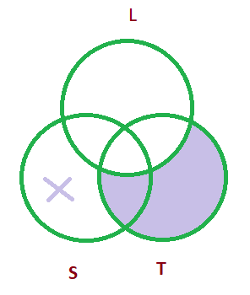
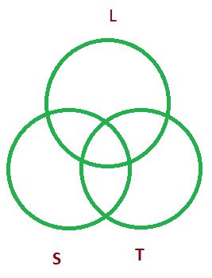
Part 3: Testing validity of a categorical syllogism
Sample 6 - Answer
Some students are not learning Categorical Logic.
Only if they learn Categorical Logic can they do the test well.
So, at least one student cannot do the test well.
Standardized argument:
Some students (S) are not CL learners (L).
All good test takers (T) are CL learners.
So, some students are not good test takers.
Symbolic argument:
Some S are not L
All T are L
So, some S are not T
This is a valid argument. There is at least one X in the area of S outside T.
Notes:
In this example, you must follow the steps:
1. Standardize all the premises and the conclusion, which are the stylistic variants.
2. Label the categories and have a formula.
3. Do the two actions (Steps 1 + 2) and remember ALWAYS to do the All or No premise before the Some premise. In this example, there are only Some premises, so you just follow the order.

Slide 43
Part 3: Testing validity of a categorical syllogism
Keep these things in mind:
Put the statements in the standard forms first.
Be consistent in how you draw your diagram: always shade the premise with No or All before putting the X for Some/some are not.
Test validity only by checking (not doing anything else) for the necessity of the conclusion.
Notes:
This slide is a summary for your step. Remember step 2: Do the premise with No or All first, and Some later.

Slide 44
MORE EXAMPLES
Translate the following syllogisms into standard categorical arguments.
Then use Venn diagram to test their validity.

Slide 45
Argument 1
All my students learn quickly.
If they are quick learners, they don’t hate Chapter 9.
So, none of my students hate Chapter 9.
A
Standardized argument:
All students (S) are quick learners (L).
No quick learners (L) are Chapter 9 haters (H).
So, no students are Chapter 9 haters.
Symbolic argument:
All S are L
No L are H
So, no S are H
A
A
Notes:
Draw Venn diagram on PPTX:
Step 1: Draw and select three interlocking circles
Step 2: Shape format -> merge shapes -> fragment
Step 3: Format shape -> pattern fill

Slide 46
Argument 2
There are students who never give any opinion.
Some students giving their opinion contribute to lessons.
So, many students do not contribute to lessons.
A
Standardized argument:
Some students (S) are not opinion givers (G).
Some opinion givers (G) are lesson contributors (C).
So, some students are not lesson contributors.
Symbolic argument:
Some S are not G
Some G are C
So, some S are not C
A
A
Notes:
Draw Venn diagram on PPTX:
Step 1: Draw and select three interlocking circles
Step 2: Shape format -> merge shapes -> fragment
Step 3: Format shape -> pattern fill

Slide 47
Argument 2
Not a student gives his or her opinion.
All giving their opinion contribute to lessons.
So, many students do not contribute to lessons.
A
Standardized argument:
No students(S) are opinion givers(O)
All opinion givers are contributors © to lessons
So, some students are not contributors to lessons
Symbolic argument:
A
A
No S are O
All O are C
So, some S are not C
Notes:
Draw Venn diagram on PPTX:
Step 1: Draw and select three interlocking circles
Step 2: Shape format -> merge shapes -> fragment
Step 3: Format shape -> pattern fill

Slide 48
Argument 3
Some students who register for Critical Thinking are frequently absent.
All students who are frequently absent cannot take the tests.
So, some students who register for Critical Thinking cannot take the test.
Standardized argument:
A
Some CT students (S) are frequent absentees (A).
No frequent absentees (A) are test takers (T).
So, some CT students are not test takers.
Symbolic argument:
Some S are A
No A are T
So, some S are not T
A
A
Notes:
Draw Venn diagram on PPTX:
Step 1: Draw and select three interlocking circles
Step 2: Shape format -> merge shapes -> fragment
Step 3: Format shape -> pattern fill

Slide 49
SELF PRACTICE
There are e-mail messages that are not spell-checked. There are interofﬁce memos that are e-mail messages. Therefore, there are interofﬁce memos that are not spell-checked.
If anything is a truck, then it is not a car. There are Mazdas that are trucks. It follows that there are Mazdas that are not cars.
Every person who drinks and drives is an irresponsible person. Not every person who talks on a car phone is an irresponsible person. Hence, not every person who talks on a car phone is a person who drinks and drives.
Joey is in kindergarten. Only children in kindergarten ﬁngerpaint in school. So, Joey ﬁngerpaints in school.
Notes:
You should do all the exercises by yourself before you check the key in the next slides.

Slide 50
Task 1
There are e-mail messages that are not spell-checked. There are interofﬁce memos that are e-mail messages. Therefore, there are interofﬁce memos that are not spell-checked.
A
Some E-mail messages are not spell-checked texts
Some interoffice memos are e-mail messages
So, some interoffice memos are not spell-checked texts
A
A
Some E are not T
Some M are E
So, some M are not T
in/valid

Slide 51
Answer 1
There are e-mail messages that are not spell-checked. There are interofﬁce memos that are e-mail messages. Therefore, there are interofﬁce memos that are not spell-checked.
Some E are not S
Some M are E
Some M are not S
Notes:
Conclusion: We expect an X on the line (the arrow) which means X can be in both outside areas of M, but there isn’t any X there. So, the conclusion is Invalid.

Slide 52
Answer 2
If anything is a truck, then it is not a car. There are Mazdas that are trucks. It follows that there are Mazdas that are not cars.
No T are C
Some M are T
Some M are not C
Notes:
Conclusion: There is at least one X in the outside are of M, so it’s valid.

Slide 53
Task 3
Every person who drinks and drives is an irresponsible person. Not every person who talks on a car phone is an irresponsible person. Hence, not every person who talks on a car phone is a person who drinks and drives.
A
A
A
in/valid

Slide 54
Answer 3
Every person who drinks and drives is an irresponsible person. Not every person who talks on a car phone is an irresponsible person. Hence, not every person who talks on a car phone is a person who drinks and drives.
All D are I
Some T are not I
Some T are not D
Notes:
Conclusion: There is at least one X in the outside are of T, so it’s valid.

Slide 55
Task 4
A
Joey is in kindergarten. Only children in kindergarten ﬁngerpaint in school. So, Joey ﬁngerpaints in school.
A
A
valid/invalid

Slide 56
Answer 4
Joey is in kindergarten. Only children in kindergarten ﬁngerpaint in school. So, Joey ﬁngerpaints in school.
All J are K
All F are K
All J are F
Notes:
Conclusion: ‘All J are F’ means all the outside area of J must be shaded, but the arrow shows one small unshaded area, so it’s invalid.

Slide 57

Review: Categorical Logic
Four categorical propositions
Rules for validity check
Venn diagram
- Draw 2 circles at bottom, one on top
- Label 2 classes in conclusion at bottom
- Perform only two actions for 2 premises
- Check validity:
Stylistic variants
+ Action for conclusion already done: Valid
All S are P:
words of extremes, positive forms
+ Action for conclusion not yet done: Invalid
No S are P:
words of extremes, negative forms
Some S are P:
more than one → nearly all, positive forms
Some S are not P:
more than one → nearly all, negative forms

Slide 58
ASSIGNMENT
Task 1: Use Venn diagram to test the validity of the THREE given arguments.
Task 2: Write TWO arguments about the given topics, then use Venn diagram to test the validity of your written arguments.
Link to submit:
https://forms.gle/hWeMGy3mSXGijeTz8

Slide 59
Names of your group

Slide 60
Question 1
If every student studies on the main campus, he/she is not taking the online lesson now.
A number of students are taking the online lesson now.
So, not all students study on the main campus.
Standardized argument:
Venn diagram
Symbolic argument:
Conclusion:

Slide 61
Question 2
A few students who want easy quizzes do not want to think deeply.
Not a student who wants easy quizzes can score high.
So, each student who wants to think deeply can get high scores.
Standardized argument:
Venn diagram
Symbolic argument:
Conclusion:
Notes:
No easy quiz wishers are

Slide 62
Question 3
Most clubs you attend can build your soft skills. If you build your soft skills now, you will definitely become efficient professionals later. So many club attendants can be more effective at work later.
Standardized argument:
Venn diagram
Symbolic argument:
Conclusion:

Slide 63
Question 4
Create a categorical syllogism: 1) with both premises in the stylistic forms and the conclusion in the standard form, and 2) about the topic of Quiz 1 questions/your result. Then check its validity using Venn diagram.
Stylistic argument:
Standardized argument:
Venn diagram
Symbolic argument:
Conclusion:

Slide 64
Question 5
Create a categorical syllogism 1) with the premises containing All & Some and the conclusion containing No, 2) all three statements must be the stylistic variants, and 3) about the topic of gains/losses of a semester with more than 20 credits. Then standardize it and check its validity using Venn diagram.
Stylistic argument:
Standardized argument:
Venn diagram
Symbolic argument:
Conclusion:

Slide 65
THANK YOU

